Slide 1
Evaluation of a Taxonomy for Communities of Practice in Large-Scaled Agile Software Development by Practitioners
14.04.2025, BT Final Presentation
Lilian Irvin

Slide 2
Agenda
1
Problem Statement & Motivation
2
Research Questions & Approach
3
Evaluation Concept
4
Expert Interviews
5
Practical Taxonomy Application
6
Survey
7
Revised Taxonomy
8
Discussion & Future Work

Slide 3
Agenda
1
Problem Statement & Motivation
2
Research Questions & Approach
3
Evaluation Concept
4
Expert Interviews
5
Practical Taxonomy Application
6
Survey
7
Revised Taxonomy
8
Discussion & Future Work

Slide 4






Problem Statement & Motivation
Challenge
Solution
Research Need
Next Step
Rapidly evolving technology and customer needs demand adaptability
Agile methods address these challenges but scaling them introduces complexity
Communities of Practice
(CoPs)
Enable knowledge sharing and collaboration across teams
&
Help solve cross-functional challenges in complex large-scaled agile
software development (LSAD) environments
Many different CoPs in LSAD exist. They differ in several things, e.g. purpose, lifespan, scope, participants, etc.
A taxonomy was developed to provide a structured overview of CoPs in LSAD
The existing taxonomy has not been evaluated yet.
But it’s important to evaluate the taxonomy in practice to make sure it supports practitioners in real-life.
Evaluate how well the taxonomy captures the essential dimensions and characteristics of CoPs in LSAD
&
how effectively it supports practitioners in applying it
within real organizational contexts
Notes:
Today, live in a world with rapidly evolving technology and fast changing customer needs
To stay competitve companies must be able to adapt -> therefore not only small companies but also larger organizations have started using agile methods in software development
Larger organizations -> transitionen
CoP = A community of practice, is a group of people with a concern, a set of problems, or a passion about the same topic, and who deepen their knowledge and expertise in this area by interacting on an ongoing basis
How CoPs address complexity -> practitioner literature suggests CoPs:
Provide a platform for sharing knowledge and expertise across teams
Enabling knowledge sharing and best practices
Foster exchange of challenges, impediments and success factors

Slide 5
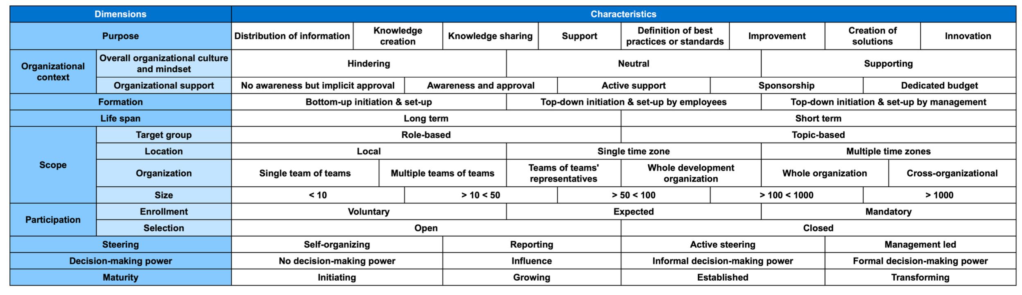
Existing Taxonomy for CoPs in LSAD proposed by Tobisch et al. (2025)
Notes:
From: „How Can CoPs in Scaled Agile Settings Look Like? Toward a Taxonomy for CoPs in Large-Scale Agile Software Development“ (Tobisch, et al.)

Slide 6
Agenda
1
Problem Statement & Motivation
2
Research Questions & Approach
3
Evaluation Concept
4
Expert Interviews
5
Practical Taxonomy Application
6
Survey
7
Revised Taxonomy
8
Discussion & Future Work

Slide 7
Research Questions
RQ 1
How can the taxonomy of CoPs in LSAD be evaluated in practice?
RQ 2
How well does the existing taxonomy fulfill the quality criteria?
RQ 3
How can the existing taxonomy of CoPs in LSAD be improved?
Notes:
RQ2 – quality criteria: completeness, conciseness, usefulness, extendibility, applicability & understandability

Slide 8

Research Approach
Research Process & Results
Knowledge Base
Problem Statement & Motivation
Literature Inputs
Background Knowledge
Structured Literature Review
Development of the Evaluation Concept
RQ 1
Related Work
Practical Inputs
Taxonomy Evaluation
Expert Interviews + Taxonomy Application
RQ 2
Survey
Identification for Improvements
RQ 3
Resulting Artifact:
Revised Taxonomy for CoPs in LSAD

Slide 9
Agenda
1
Problem Statement & Motivation
2
Research Questions & Approach
3
Evaluation Concept
4
Expert Interviews
5
Practical Taxonomy Application
6
Survey
7
Revised Taxonomy
8
Discussion & Future Work

Slide 10
Overview – Literature Search for the Development of an Evaluation Concept
Steps
1. Database Selection
2. Search Phrase Selection
Literature Search
Literature screening and filtering*
Forward and Backward Search
IEEE
ACM
AIS
Science Direct (SD)
Web of Science (WoS)
“taxonomy”
AND
"evaluation”
AND
("software engineering”
OR
"information
systems")
  Total Number of Results Found:
  131
  Total Number of Remaining Results:
  15
  Total Number of Final Results:
  20
+ 5 Results
Results
Database | Results
IEEE | 21
ACM | 17
AIS | 29
SD | 55
WoS | 9
Information on taxonomy evaluation in general ***
Evaluation
by
Interview Method **
Evaluation
by
Taxonomy Application **
3
9
7
* Filtering for relevant literature, e.g. removing duplicates, removing literature with irrelevant content for this research
** Some did both, the interview method and the taxonomy application
*** e.g.: a structured overview of how taxonomies are evaluated in information systems

Slide 11
Overview – Literature Search for the Development of an Evaluation Method
Steps
…
Final Search Results
…
  Total Number of Results:
  20
Evaluation Method Overview
by Kundisch et al. (2022)
Expert Interviews
& Practical Application
58%
Taxonomy Application with real world objects
Survey
Input | % of Literature Found
General Information | 40%
Interviews & Practical Application | 35%
Interviews | 10%
Survey | 5%
Other | 10%
Results
15%
Taxonomy Application with existing research
9%
Expert Interviews
7%
Surveys
Vgl. D. Kundisch, J. Muntermann, A.-M. Oberländer, and J. Schlüter (2022)

Slide 12
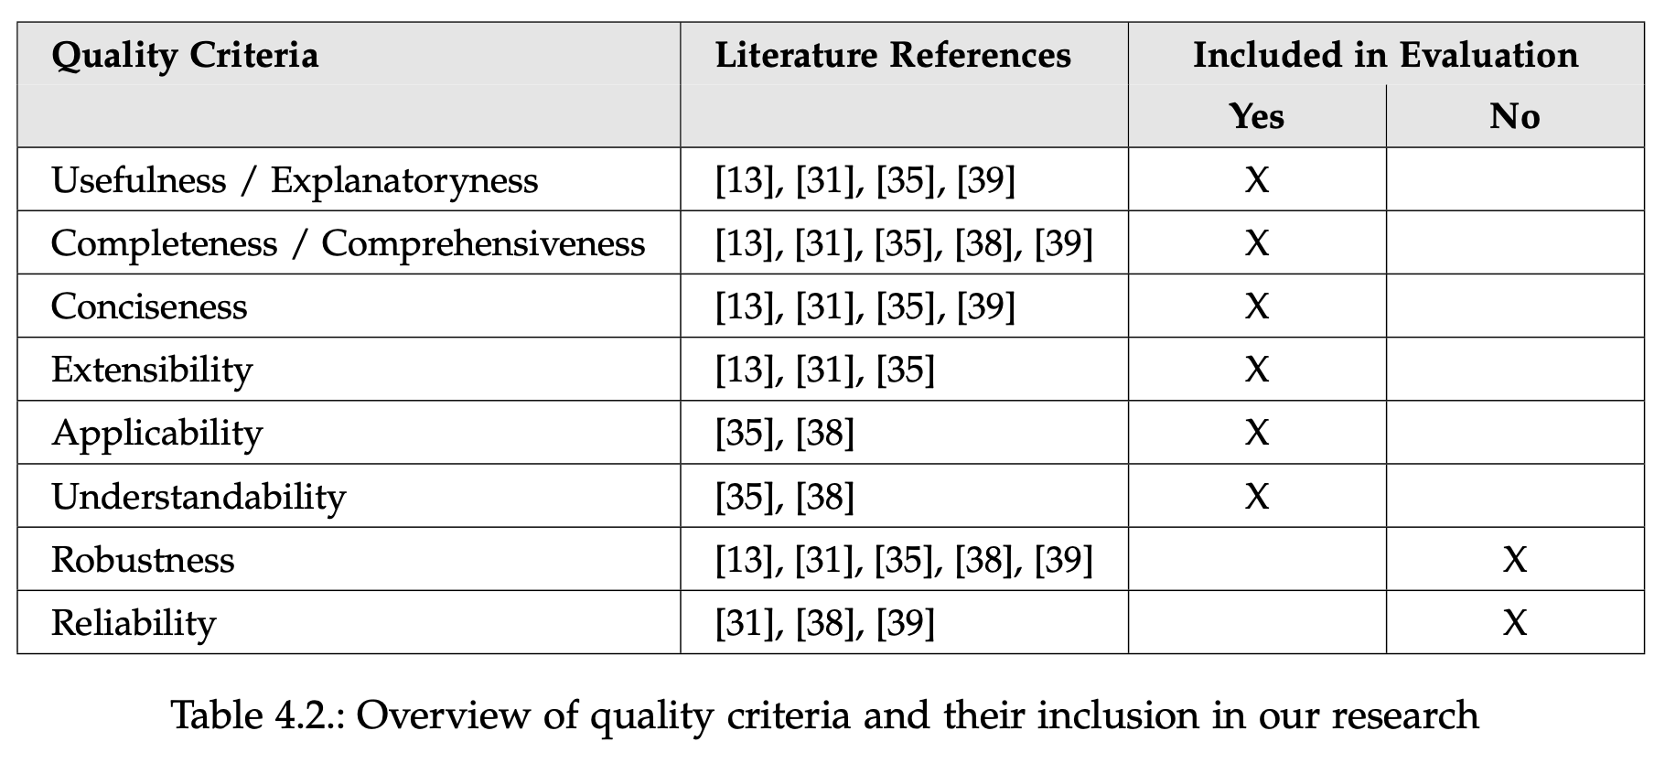


Overview – Literature Search for the Development of Quality Criteria
Literature review
1
Identification of quality criteria used
2
Combination of quality criteria
3
Selection of most used quality criteria
4
Selection of quality criteria
5
Reasons for not including Robustness & Reliability:
Not possible due to constraints:
Time
Resources

Slide 13






Literature Review Results – Quality Criteria
Selected Criteria
Completeness
Conciseness
Expandability
Usefulness
Understandability
Applicability

Slide 14
Literature Review Results – Quality Criteria
Selected Criteria
Completeness
Conciseness
Expandability
Can all CoPs in LSAD be classified with the taxonomy?
Are there too many dimensions or characteristics to handle the taxonomy comfortably?
Can the dimensions and characteristics of the taxonomy be adjusted or expanded in the future?
Are the dimensions and characteristics of the taxonomy complete?

Slide 15
Literature Review Results – Quality Criteria
Selected Criteria
Usefulness
Understandability
Applicability
Case 1
Does the taxonomy serve as a source of inspiration?
Are the dimensions and characteristics of the taxonomy easy to understand?
Can the taxonomy be easily applied in practice?
Case 2
Does the taxonomy support in the establishment of CoPs in LSAD?
Case 3
Does the taxonomy evaluate existing CoPs in LSAD?
Case 4
Would best practices for CoPs in LSAD be helpful?

Slide 16
Agenda
1
Problem Statement & Motivation
2
Research Questions & Approach
3
Evaluation Concept
4
Expert Interviews
5
Practical Taxonomy Application
6
Survey
7
Revised Taxonomy
8
Discussion & Future Work

Slide 17

Expert Interviews – Participants & Set-Up
Details
Process
3 interviews with experts that have experience with CoPs and LSAD
online via video call
30-60 min long
semi-structured with interview guide
Introduction of research and taxonomy
General question (job role & CoP experience)
Questions based on quality criteria:
  Likert-Scale (1 strongly disagree – 5 strongly agree)
  Open question for deeper insights
Taxonomy application by experts to real-life CoP example
Participants
Expert 1
Expert 2
Expert 3
Industry
Household Appliances
Information and Communication Technology
Household Appliances
Job Role
Chapter Lead for Enterprise Architecture
Enterprise Architect
Agile Master
CoP Engagement
Organizing, Coordinating, Leading, and Participating
Founding, Leading,
and Participating
Leading, Participating, Refining, and Improving

Slide 18


Expert Interviews – Results
Overall summary
Overall Completeness
1 of 3 experts mentioned a missing dimension “Content”
1 of 3 experts mentioned the missing cultural aspects included in the dimension Location
Overall Conciseness
Usefulness
1 of 3 experts recommends reducing the dimension Size from 5 to 3 characteristics
2 of 3 experts thought about combining characteristics in the dimension Purpose but finally rejected this idea
Expandability
Understandability
1 of 3 experts asked for key metrics on how to know whether their CoP is successful
Applicability
Short definitions for each dimension/characteristics were needed
1 of 3 experts had difficulties understanding the dimensions Organization

Slide 19
Agenda
1
Problem Statement & Motivation
2
Research Questions & Approach
3
Evaluation Concept
4
Expert Interviews
5
Practical Taxonomy Application
6
Survey
7
Revised Taxonomy
8
Discussion & Future Work

Slide 20
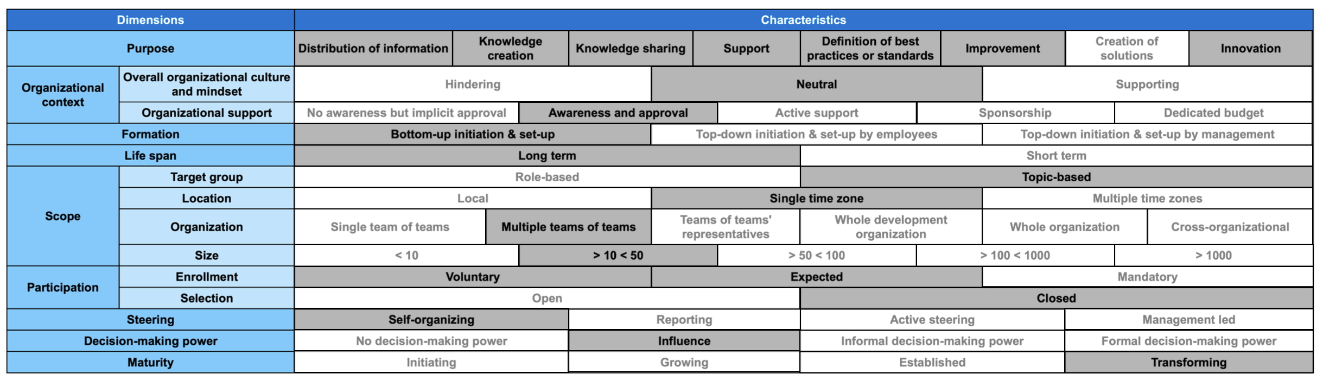
Expert Interviews – Practical Taxonomy Application Example and Value
Expert 2
Example CoP: Participants own CoP called ”Data Community”
Value of practical application as part of the expert interviews:
Direct Insights
Indirect Insights
Applicability
Completeness
Understandability
Conciseness
Usefulness
Notes:
Expert 2 Insights:
Usefulness: automatically evaluated CoP → too many purposes – either reduce or split CoP into two
Taxonomy understandable but short definitions required
Taxonomy was easily applied
Dimension “Selection” – no differentiation between read and write access (within his organization sometimes you can read but not actively participate, etc.)

Slide 21
Practical Taxonomy Application – Results
Overall summary
Applicability
1 of 3 experts struggled choosing a characteristics within Selection as there was no differentiation between read and write access
Understandability
Usefulness
Short definitions for each dimension/characteristics were needed
1 of 3 experts had difficulties understanding the dimensions Organization
Overall Completeness
Conciseness

Slide 22
Agenda
1
Problem Statement & Motivation
2
Research Questions & Approach
3
Evaluation Concept
4
Expert Interviews
5
Practical Taxonomy Application
6
Survey
7
Revised Taxonomy
8
Discussion & Future Work

Slide 23

Survey – Participants & Set-Up
Details
Survey Questions
Online survey
No changes to the taxonomy at this step
Changes to the expert questions, based on the interview feedback
Collection of general information:
  job role
  experience with CoPs
Likert scale questions from the expert interviews remained
Based on the interview feedback, additional questions were added:
  Individual questions for completeness and conciseness of each dimension
  Should ”Coordination” be added to the purpose dimension?
  Should the characteristics within the dimension Size be reduced to three?
  Open text / multiple-choice questions for any missing dimension, unnecessary dimensions, unclear dimensions
Open Feedback at the end of the survey
Participants
Expert 1-15
Job Roles
Agile Coaches & Consultants & Leads, Scrum Masters & Leads,
Software Developer,
Business Agility Consultants,
etc.
CoP Engagements
Leaders, Participants & Coaches

Slide 24
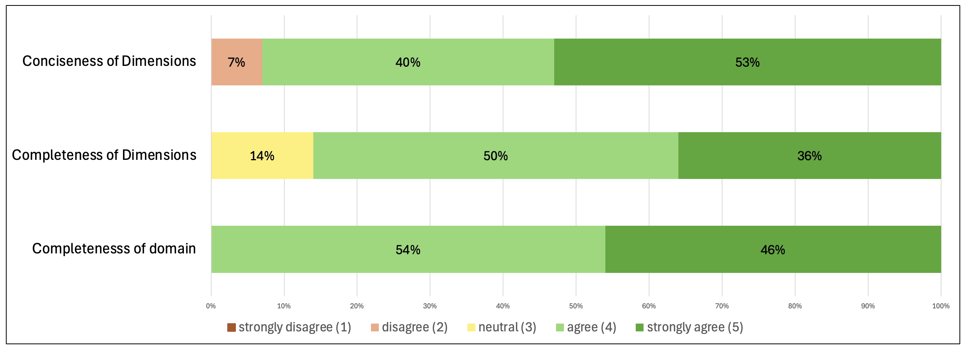
Survey – Results I/IV
Completeness & Conciseness of the Characteristics and Dimensions
Characteristics
Dimensions
Characteristics are overall complete
Lowest ratings for the dimensions:
Location
Overall organizational culture and mindset
Purpose
Characteristics are overall concise
Dimensions are overall complete and concise
Lowest ratings for the dimensions:
1 of 15 participants mentioned missing dimensions, e.g. "Regular Participation" or "Reach for audience"
Purpose
Size
No strong evidence that a dimension should be removed or combined

Slide 25
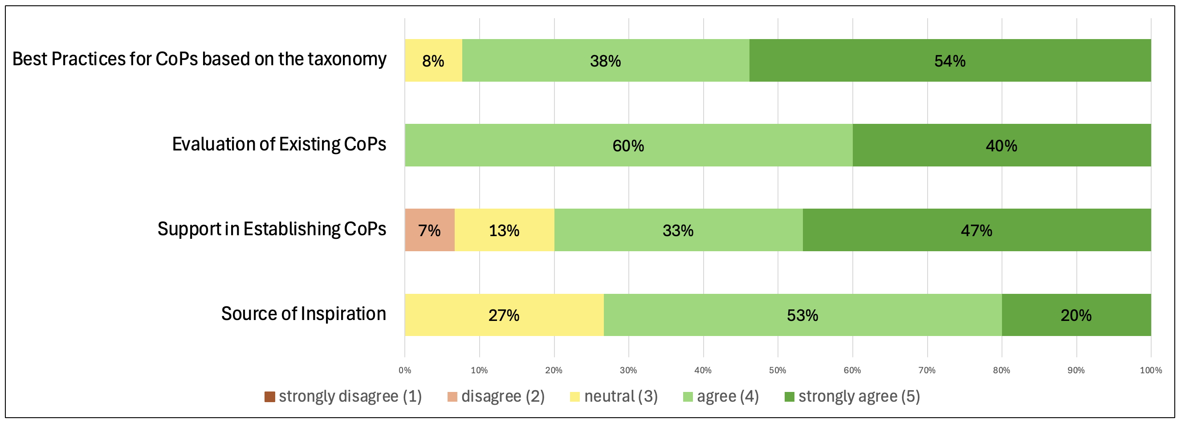
Survey – Results II/IV
Usefulness
Support in Establishing CoPs
Best Practices for CoPs
agreement
Strong agreement *
Inspiration for CoPs
Evaluation of CoPs
* Based on mean of survey answers

Slide 26
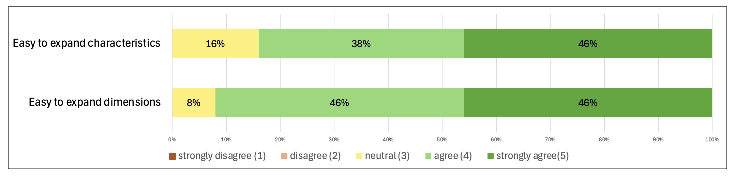
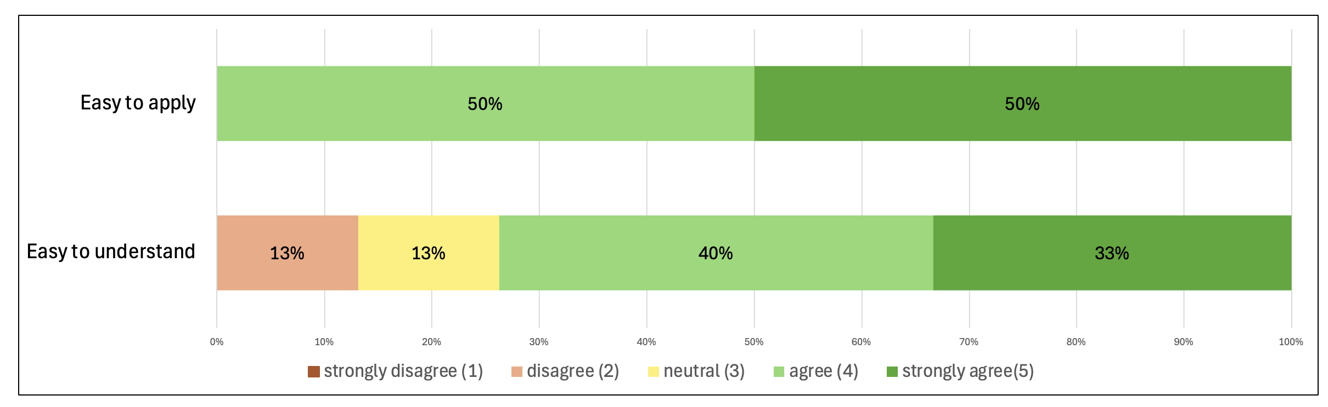
Survey – Results III/IV
Expansibility, Understandability, Applicability
Expandability
Applicability
*
Understandability
* No strong evidence which dimension or characteristics are difficult to understand

Slide 27
Survey Results IV/IV – Open Feedback
“Good work! I really like to leverage the taxonomy for our team in order to categorize future CoPs or evaluate existing CoPs or evaluate existing CoPs and have more clarity on each CoP’s characteristics.
Based on the characteristics it would then be great to have a set of recommendations on how to steer CoPs into a effective direction”
by P2
“I think it is very useful, thank you for developing this.
I personally would not create best practices from this, but rather provide a description of the as-is situation of many CoPs in practice right now, along with trade-offs, caveats, risks, contexts and benefits of choosing different characteristics (which could turn into some form of recommendation but doesn’t have to because every setup is so unique).”
by P4
“Good job! Very interesting setup, and can be useful in the industry!”
by P14

Slide 28
Agenda
1
Problem Statement & Motivation
2
Research Questions & Approach
3
Evaluation Concept
4
Expert Interviews
5
Practical Taxonomy Application
6
Survey
7
Revised Taxonomy
8
Discussion & Future Work

Slide 29
Taxonomy Evaluation Results
Overall summary
Overall Completeness
Individual dimensions were mentioned, but no strong evidence towards on specific dimension or characteristic
Overall Conciseness
Usefulness
Dimension Size was identified as not concise enough
Expandability
Different opinions on how best practices could look like
Understandability
Applicability
Individual dimension were mentioned as difficult to understand, but no strong evidence towards a specific dimension

Slide 30
Revised Taxonomy of CoPs in LSAD
Building on taxonomy proposed by Tobisch et al. (2025)
Dimensions
Characteristics
Purpose
Distribution of Information
Knowledge Creation
Knowledge Sharing
Support
Definition of Best Practices or Standards
Improvement
Creation of Solutions
Innovation
Organizational Context
Overall Organizational Culture & Mindset
Hindering
Neutral
Supporting
Organizational Support
No Awareness but Implicit Approval
Awareness and Approval
Active Support
Sponsorship
Dedicated Budget
Formation
Bottom-Up Initiation & Set-up
Top-Down Initiation & Set-up by Employees
Top-Down Initiation & Set-up by Management
Life span
Long Term
Short Term
Scope
Target Group
Role-based
Topic-based
Location
Local
Similar Time Zone
Different Time Zone
Organization
Single Team of Teams
Multiple Team of Teams
Teams of Teams’ Representatives
Whole Development Organization
Whole Organization
Cross-Organizational
Size
< 10
> 10 < 50
> 50 < 1000
> 1000
Participation
Enrollment
Voluntary
Expected
Mandatory
Selection
Open
Closed
Steering
Self-Organizing
Reporting
Active Steering
Management Led
Decision-Making Power
No Decision-Making Power
Influence
Information Decision-Making Power
Formal Decision-Making Power
Maturity
Initiating
Growing
Established
Transforming
Reduction of the number of characteristics of the dimension Size (from five to four characteristics)
→ Combination of “>50 < 100” and “>100 <1000” to “>50 < 1000”
Notes:
Purpose: not complete but not concise either – no changes
Size: not concise enough -- reduction to 4 characteristics
Location: missing characteristics “Hybrid” or cultural differences → evidence not strong enough to add – more research required
Understandability: overall well – provide one pager for easier clarity of all dimensions? (small definition)

Slide 31
Agenda
1
Problem Statement & Motivation
2
Research Questions & Approach
3
Evaluation Concept
4
Expert Interviews
5
Practical Taxonomy Application
6
Survey
7
Revised Taxonomy
8
Discussion & Future Work

Slide 32



Summary, Limitations, and Future Work
Summary of Findings
Future Work
The taxonomy proposed by Tobisch et al. (2025) is already well defined overall.
The taxonomy is very easy to apply and expand in the future.
With short definition for each dimension, the taxonomy is easy to understand.
The taxonomy is useful in practice.
There is no strong evidence that a dimension / characteristic is missing
Overall the taxonomy is concise, but the dimension Size should have less characteristics.
Additional evaluation round regarding the revised taxonomy
Gathering mor in depth information from practitioners regarding some dimensions, e.g. purpose, as there have been individual feedbacks, but no strong evidence yet
Evaluate taxonomy regarding two other add quality criteria: robustness, reliability
Longer and larger studies (e.g. interviews or surveys with more participants)
Provide supporting material, e.g. best practices, real world examples, as-is analysis, etc.
Limitations
Resources
(e.g. study duration and sizes)
Interview coding and survey analysis only done by one researcher
Time

Slide 33
Lilian Irvin
Bachelor Student Information Systems

Slide 34
References
D. Kundisch, J. Muntermann, A.-M. Oberländer, and J. Schlüter, “An update for taxonomy designers”, Business & Information Systems Engineering, vol. 64, no. 4, pp. 421–439, Aug. 2022. doi: 10 . 1007 / s12599 - 021 - 00723 - x. [Online]. Available:
https://doi.org/10.1007/s12599-021-00723-x.
D. Leffingwell, Scaling software agility: best practices for large enterprises. Pearson Education, 2007.
Nickerson, R. C., Varshney, U., & Muntermann, J. (2013). A method for taxonomy development and its application in information systems. European Journal of Information Systems, 22(3), 336-359.
M. Paasivaara and C. Lassenius, “Communities of practice in a large distributed agile software development organization – case ericsson”, Information and Software Technology, vol. 56, no. 12, pp. 1556–1577, 2014, Special issue: Human Factors in Software Development, issn: 0950-5849. doi: https://doi.org/10.1016/j.infsof.2014.06.008. [Online]. Available: https://www.sciencedirect.com/science/article/pii/
S0950584914001475.
D. Reifer, F. Maurer, and H. Erdogmus, “Scaling agile methods”, IEEE Software, vol. 20, no. 4, pp. 12–14, 2003. doi: 10.1109/MS.2003.1207448.
D. Szopinski, T. Schoormann, and D. Kundisch, “Criteria as a prelude for guiding taxonomy evaluation”, 2020.
Tobisch, F., Schmidt, J., & Matthes, F. (2024). Investigating Communities of Practice in Large-Scale Agile Software Development: An Interview Study. In: Smite, D., Guerra, E., Wang, X., Marchesi, M., Gregory, P. (eds) Agile Processes in Software Engineering and Extreme Programming. XP 2024. Lecture Notes in Business Information Processing, vol 512. Springer, Cham. https://doi.org/10.1007/978-3-031-61154-4_1
Tobisch, F., Schmidt, J., & Matthes, F. (in press). How Can CoPs in Scaled Agile Settings Look Like? Toward a Taxonomy for CoPs in Large-Scale Agile Software Development [Unpublished manuscript].
M. Unterkalmsteiner and W. Abdeen, “A compendium and evaluation of taxonomy quality attributes”, Expert Systems, vol. 40, no. 1, Jul. 2022, issn: 1468-0394. doi: 10.1111/exsy.13098. [Online]. Available: http://dx.doi.org/10.1111/exsy.13098.
M. Usman, R. Britto, J. Börstler, and E. Mendes, “Taxonomies in software engineering: A systematic mapping study and a revised taxonomy development method”, Information and Software Technology, vol. 85, pp. 43–59, 2017.
E. Wenger-Trayner and B. Wenger-Trayner, An introduction to communities of practice: A brief overview of the concept and its uses, Available from authors, 2015. [Online]. Available: https://www.wenger- trayner.com/introduction- to- communities- of- practice (visited on 01/03/2025)

Slide 35


Appendix

Slide 36
Literature Review Results – Quality Criteria
Selected Criteria
Completeness
Conciseness
Usefulness
Can all CoPs in LSAD be classified with the taxonomy?
Are there too many dimensions or characteristics to handle the taxonomy comfortably?
Case 1
Does the taxonomy serve as a source of inspiration?
Are the dimensions and characteristics of the taxonomy complete?
Understandability
Case 2
Does the taxonomy support in the establishment of CoPs in LSAD?
Expandability
Are the dimensions and characteristics of the taxonomy easy to understand?
Case 3
Does the taxonomy evaluate existing CoPs in LSAD?
Applicability
Can the dimensions and characteristics of the taxonomy be adjusted or expanded in the future?
Case 4
Would best practices for CoPs in LSAD be helpful?
Can the taxonomy be easily applied in practice?

Slide 37
Expert Interviews – Results
Interview Coding Categories and Subcategories
Completeness
Conciseness
Usefulness
Classification of all CoPs in LSAD
Overall Conciseness of the Taxonomy
Inspiration for CoPs in LSAD
Overall Completeness of Dimensions and Dimensions
Adjustments of the Dimensions Size
Establishment of CoPs in LSAD
Missing Dimensions or Aspects
Adjustments of the Dimensions Purpose
Evaluation of CoPs in LSAD
Best Practices for CoPs in LSAD
Expandability
Applicability
Understandability
Other
Overall Expandability
Overall Applicability
Overall Understandability
Definition of CoPs

Slide 38
Expert Interviews – Results I/II
Interview Coding Categories and Subcategories
Completeness
Conciseness
Usefulness
Strong Agreement:
Agreement:
Agreement:
Classification of all CoPs in LSAD
Overall Conciseness of the Taxonomy
Inspiration for CoPs in LSAD
Overall Completeness of Dimensions and Dimensions
2 of 3 experts think taxonomy is overwhelming at first but makes sense
1x Strong agreement, 1x agreement, 1x neutral - disagreement
Feedback to discuss:
Establishment of CoPs in LSAD
Feedback to discuss:
Adjustments of the Dimensions Size
Strong agreement, but ask for key metrics by 1 participants
Missing Dimensions or Aspects
1 of 3 experts recommends reducing the dimension from 5 to 3 characteristics
Evaluation of CoPs in LSAD
1 of 3 experts mentioned a missing dimension “Content”
1 of 3 experts mentioned the missing cultural aspects included in the dimension Location
Adjustments of the Dimensions Purpose
Best Practices for CoPs in LSAD
2 of 3 experts thought about combining characteristics but finally rejected this idea
Difficulties understanding the use case

Slide 39
Expert Interviews – Results II/II
Interview Coding Categories and Subcategories
Expandability
Understandability
Summary
Overall positive feedback for all quality criteria
Ideas for improvement, especially within the completeness and conciseness of the taxonomy
Evidence not strong enough to make any adjustments to the taxonomy yet
Adjustments of the evaluation questions within the survey
Strong Agreement:
Agreement:
Overall Expandability
Overall Understandability
Small definitions for each dimension/characteristics were needed
1 of 3 experts had difficulties understanding the dimensions Organization
Applicability
Other
Strong Agreement:
Definition of CoPs
Overall Applicability
Unclear definition of CoPs and different names in practice were mentioned

Slide 40
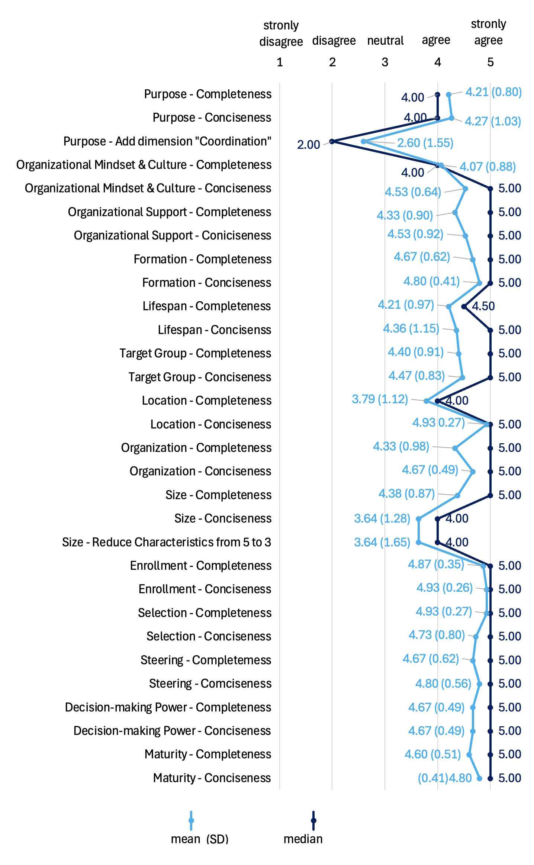
Survey – Results I/IV
Completeness & Conciseness of the Characteristics
Overall positive results
Lowest ratings for the dimensions:
Completeness
Location
Overall organizational culture and mindset
Purpose
Results show a tendency to reduce the number of characteristics
Overall positive results
Lowest ratings for the dimensions:
Conciseness
Size
Purpose

Slide 41
Comparison of the Evaluation Results
Expert Interviews, Practical Taxonomy Application, and Survey
Completeness
Conciseness
Usefulness
The taxonomy can classify all CoPs in LSAD
Overall: the taxonomy is concise
Feedback for Improvement:
Individual dimensions were mentioned as not concise enough
Case 1
Does the taxonomy serve as a source of inspiration?
Overall: the taxonomy is complete
Feedback for Improvement: individual dimension or characteristics were mentioned as missing, but no strong evidence
Case 2
Does the taxonomy support in the establishment of CoPs in LSAD?
Expandability
Understandability
Case 3
Does the taxonomy evaluate existing CoPs in LSAD?
The taxonomy can be easily expanded or adjusted in the future
Overall: the taxonomy is easy to understand
Feedback for Improvement: individual dimensions or characteristics were mentioned as difficult to understand, but no strong evidence
Case 4
Would best practices for CoPs in LSAD be helpful?
Applicability
The taxonomy can be easily applied in practice
However, different opinions on how best practices should look like
Very positive feedback
Positive feedback

Slide 42
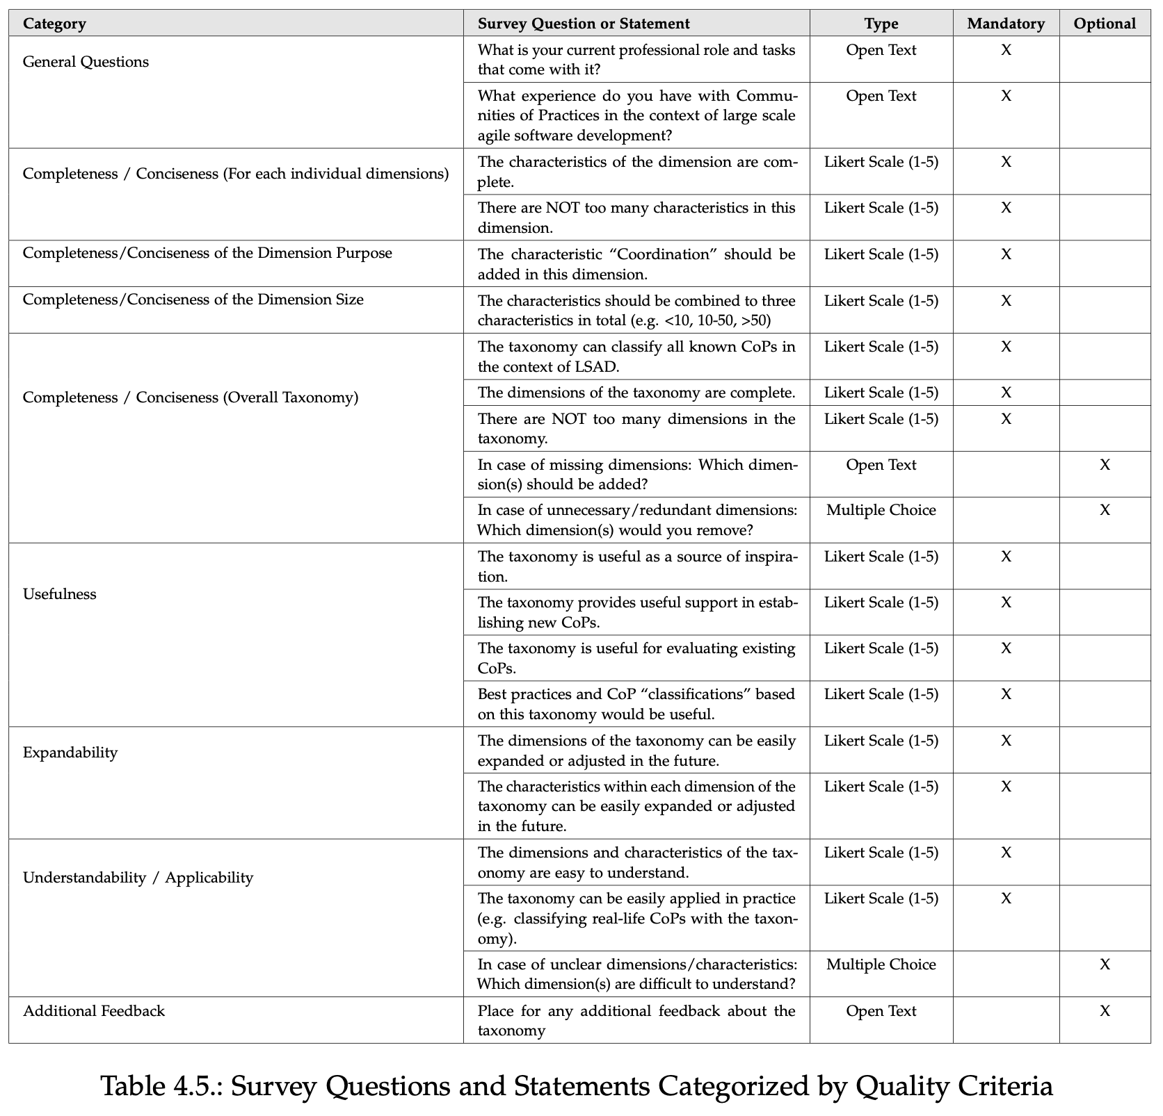
Survey – Participants & Set-Up
Details
Online survey
Likert-Scale questions regarding the quality criteria
Additional questions for further insights: open text and multiple-choice
Participants
Expert 1-15
Job Roles
Agile Coaches & Consultants & Leads, Scrum Masters & Leads,
Software Developer,
Business Agility Consultants,
etc.
CoP Engagements
Leaders, Participants & Coaches
* Additional questions added to the survey due to feedback from expert interviews and taxonomy application

